Slide 1
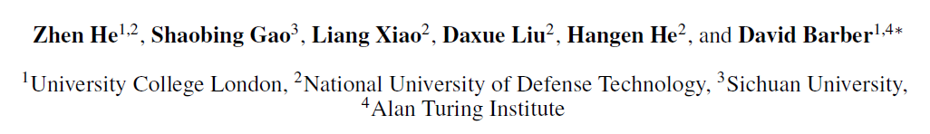
Wider and Deeper, Cheaper and Faster: Tensorized LSTMs for Sequence Learning
(NIPS 2017)

Slide 2
Overview
Idea: Tensorizing hidden-state vector to higher dimension
+ Cross-layer convolution
Used in: Sequence learning
Contribution:
Widen networks without additional parameters by sharing parameters
“Deepen” networks with little additional runtime by delaying the output
(merging deep computations into temporal computations)

Slide 3




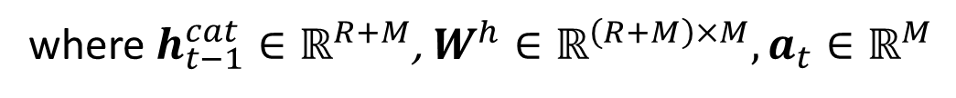


Tensorized RNN (tRNN)
RNN:
$$φ=element−wise tanh$$
$$φ=any differentiable function$$
where$h_{t−1}^{cat}∈ℝ^{R+M}$, $W^{h}∈ℝ^{\left(R+M\right)×M}, a_{t}∈ℝ^{M}$

Slide 4
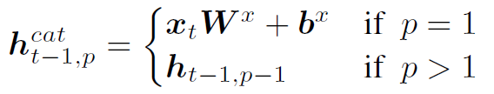




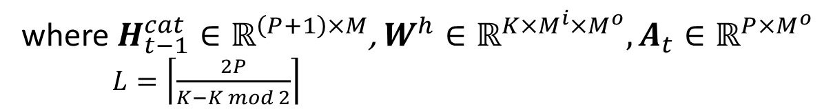


Tensorized RNN (tRNN)
tRNN:
$$⊛ =convolution operator$$
$$φ=element−wise tanh$$
$$φ=any differentiable fuction$$
where$H_{t−1}^{cat}∈ℝ^{\left(P+1\right)×M}$,$W^{h}∈ℝ^{K×M^{i}×M^{o}},A_{t}∈ℝ^{P×M^{o}}$
$L=\left\lceil \frac{2P}{K−K mod 2}\right\rceil$

Slide 5










Tensorized RNN (tRNN)
$$h_{t−1}^{cat}$$
$$W^{h}$$
RNN:
R+M
m
M
$$a_{t,m }$$
R+M
tRNN:
$$H_{t−1}^{cat}$$
$$W^{h}$$
$$M^{i}$$
$$M^{i}$$
$$m^{o}$$
p
$$M^{o}$$
$$A_{t,p,m^{o}}$$
P+1
K

Slide 6
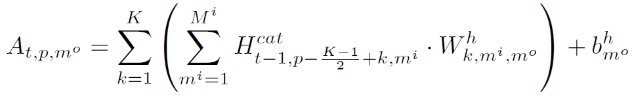
Tensorized RNN (tRNN)
tRNN:
$$H_{t−1}^{cat}$$
$$W^{h}$$
$$M^{i}$$
$$M^{i}$$
channel vector at location p
$$m^{o}$$
p
$$M^{o}$$
$$A_{t,p,m^{o}}$$
P+1
K

Slide 7










Tensorized RNN (tRNN)
tRNN: delayed output
$$H_{t}^{cat}$$
$$H_{t+1}^{cat}$$
$$H_{t+2}^{cat}$$
$$H_{t+3}^{cat}$$
$$x^{t}$$
1
$$M^{i}$$
1
$$M^{i}$$
1
$$M^{i}$$
1
$$M^{i}$$
2
2
2
2
3
3
3
3
4
4
4
4
$$y^{t}$$
K=2, L=P=3

Slide 8
Tensorized RNN (tRNN)

Slide 9
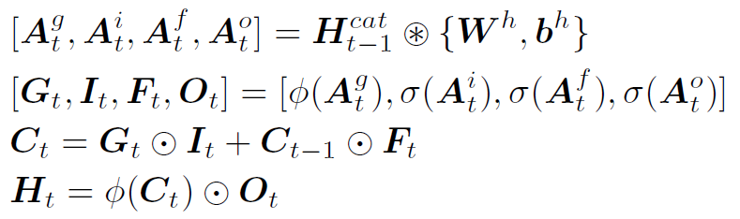
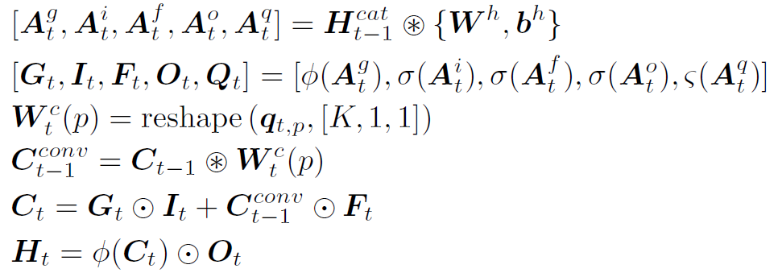
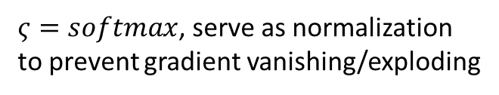

tLSTM
where$A_{t}^{q}∈ℝ^{P×\left\langle K\right\rangle }$
$ς=softmax$, serve as normalization
to prevent gradient vanishing/exploding

Slide 10
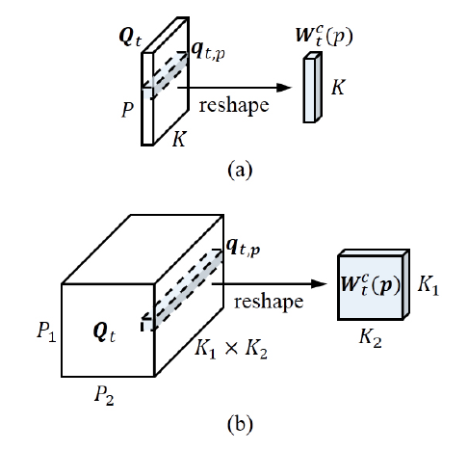
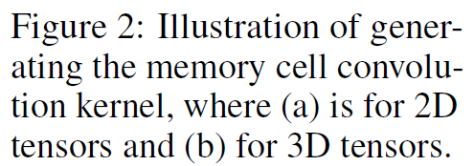
tLSTM

Slide 11
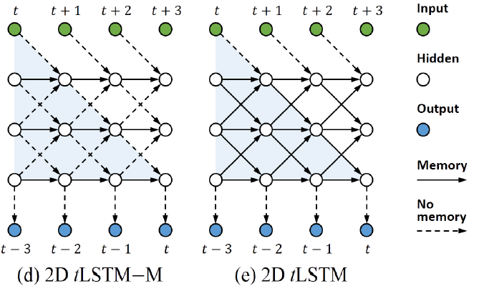
tLSTM

Slide 12



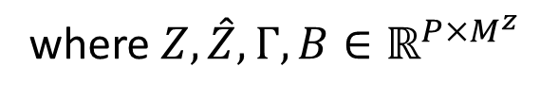

Channel Normalization
$$H_{t−1}^{cat}$$
1
$$M^{i}$$
Channel Normalization:
p
P+1
Layer Normalization: does not work well
where$Z,\hat{Z},Γ,B∈ℝ^{P×M^{z}}$

Slide 13
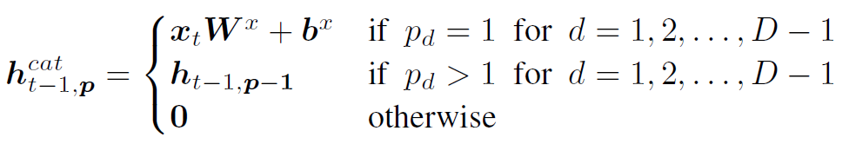




Higher-Dimensional Tensors
put the projection of $x^{t}$ to the corner
$$x$$
$$0$$
$$H_{t−1}^{cat}$$

Slide 14
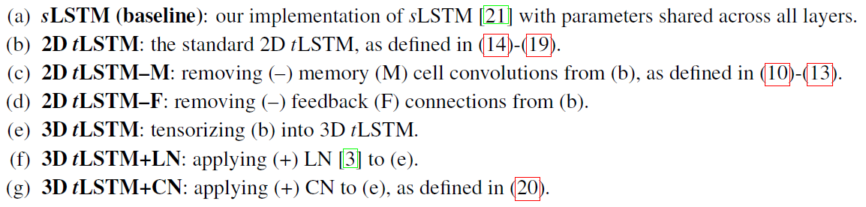
Experiments 0. model configurations

Slide 15
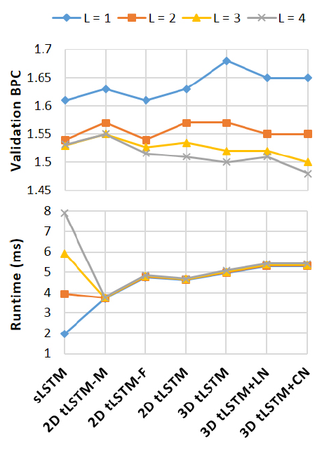
Experiments I. Wikipedia Language Modeling
Task: compression contest
Dataset: the Hutter Prize Wikipedia
Measurement: bits per character (BPC)
Setting: fix the parameter number to 10M
by changing channel-size M.
Result:
L ≤ 2: simpler models with larger M win.
L > 2: memory cell convolution (MCC) works.
CN consistently better.

Slide 16
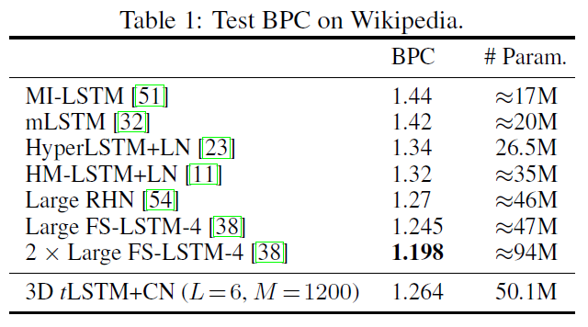
Experiments I. Wikipedia Language Modeling
Task: compression contest (language modeling)
Dataset: the Hutter Prize Wikipedia

Slide 17


Experiments II. Algorithm Tasks
Addition: to sum two 15-digit integers
Memorization: to memorize
a sequence of 20 random symbols
Setting: M=400 for Addition, M=100 for Memorization
Result:
Models without MCC degrade as L increase.
LN helps little.

Slide 18
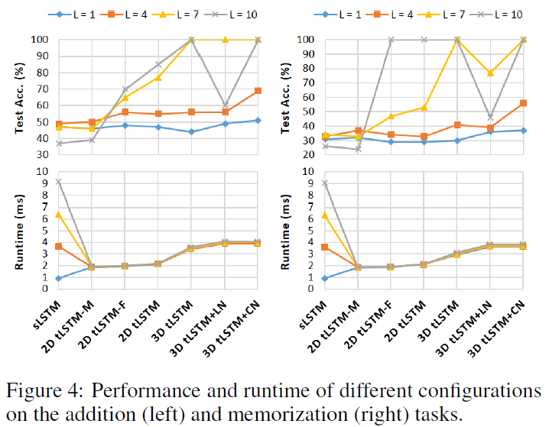
Experiments II. Algorithm Tasks

Slide 19
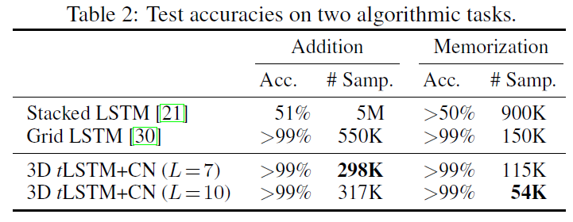
Experiments II. Algorithm Tasks
# of training examples to achieve perfect performace

Slide 20
Experiments III. MNIST Image Classification
Sequential MNIST
Sequential Permuted MNIST: permute pixels with the same random matrix
Setting: M=100
Result:
Models without MCC degrade as L increase.
All tLSTMs become faster when L=5.

Slide 21
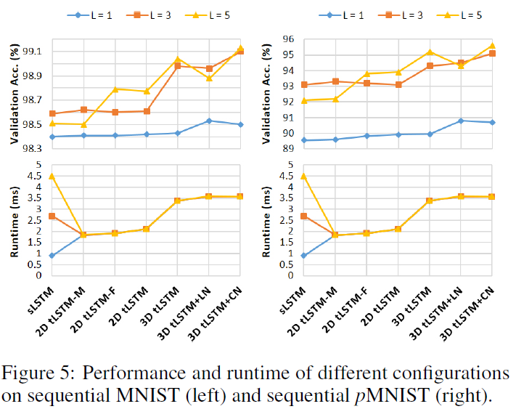
Experiments III. MNIST Image Classification

Slide 22
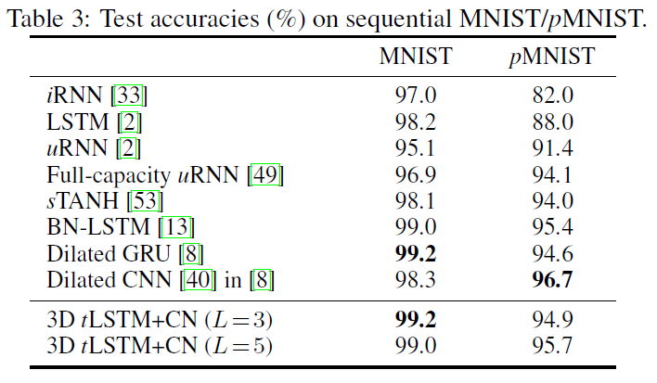
Experiments III. MNIST Image Classification

Slide 23
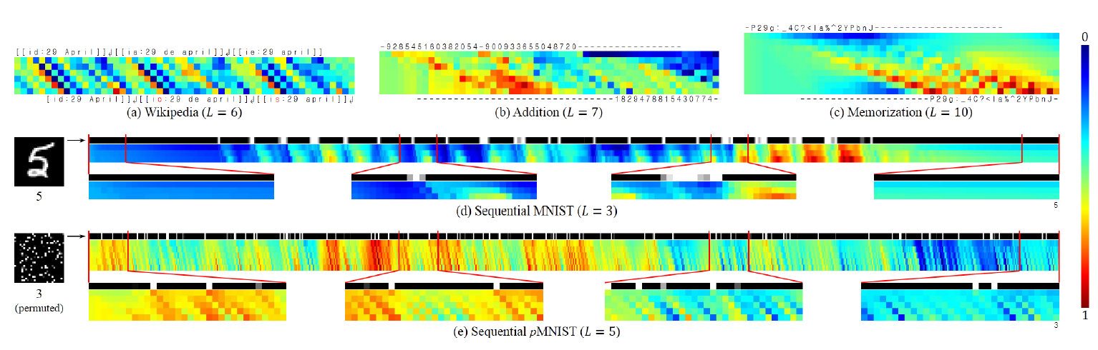
Experiments IV. Visualization
from the input to the output, the values become increasingly distinct and are shifted temporally, revealing that deep computations are indeed performed together with temporal computations, with long-range dependencies carried by memory cells.

Slide 24
Thanks for Listening!
Any Questions?

